Slide 1
CSE-3213
Computer Graphics Lecture 20

Slide 2
Video Display Devices
Cathode-ray tube (CRT) Monitor
Rater-Scan Displays
Random-Scan Displays
Color CRT Monitors
Flat-Panel Displays

Slide 3
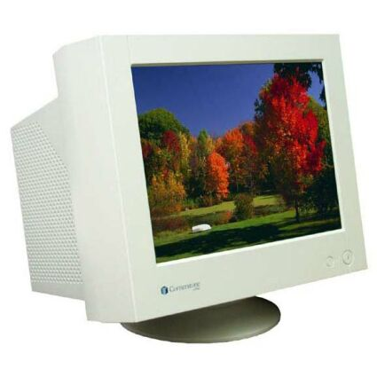
Cathode-ray tube (CRT) Monitors
The primary output device in a graphics system is a video monitor.
The operation of most video monitors is based on the standard cathode-ray
tube (CRT) design

Slide 4
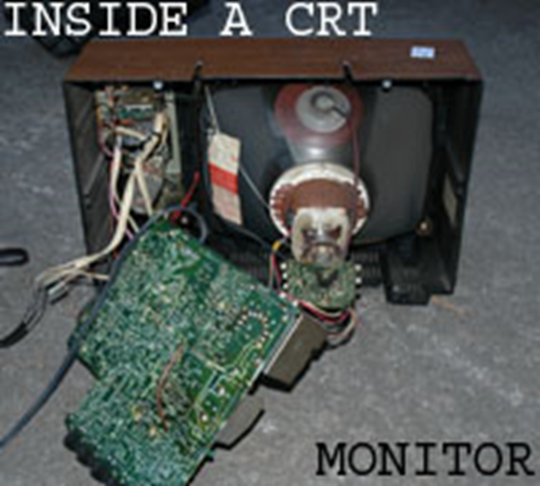
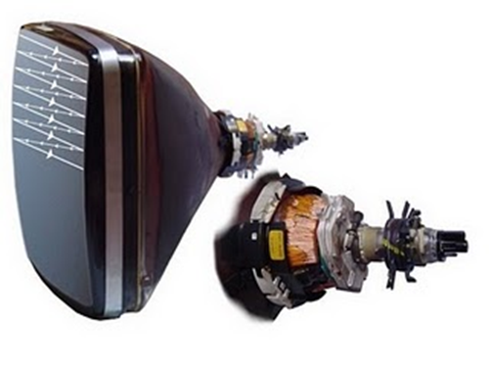
Cathode-ray tube (CRT) Monitors

Slide 5
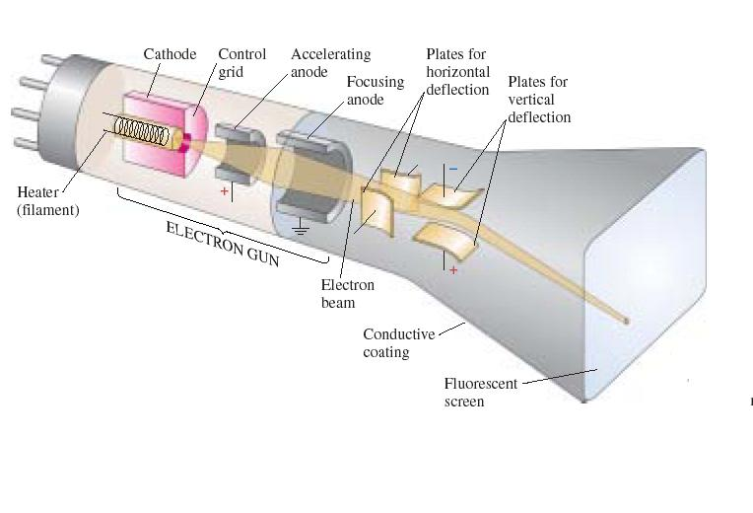
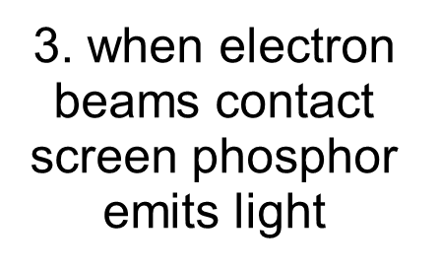



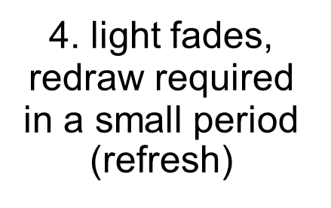
CRT

Slide 6
CRT types
Raster-scan (point by point refreshing)‏
Refresh rate: # of complete images (frames) drawn on the screen in 1 second. Frames/sec.
Frame time: reciprocal of the refresh rate, time between each complete scan. sec/frame

Slide 7
Cathode-ray tube (CRT) Monitors
Refresh CRT
Beam of electrons hit phosphor-coated screen, light emitted by phosphor
Direct electron beam to the same screen repeatedly, keeping phosphor activated
The frequency at which a picture is redrawn on the screen is referred to as the “refresh rate”
The maximum number of points that can be displayed on a CRT is referred to as the “resolution”
Display principle
Raster Scan Display Principle
Random Scan Display Principle

Slide 8
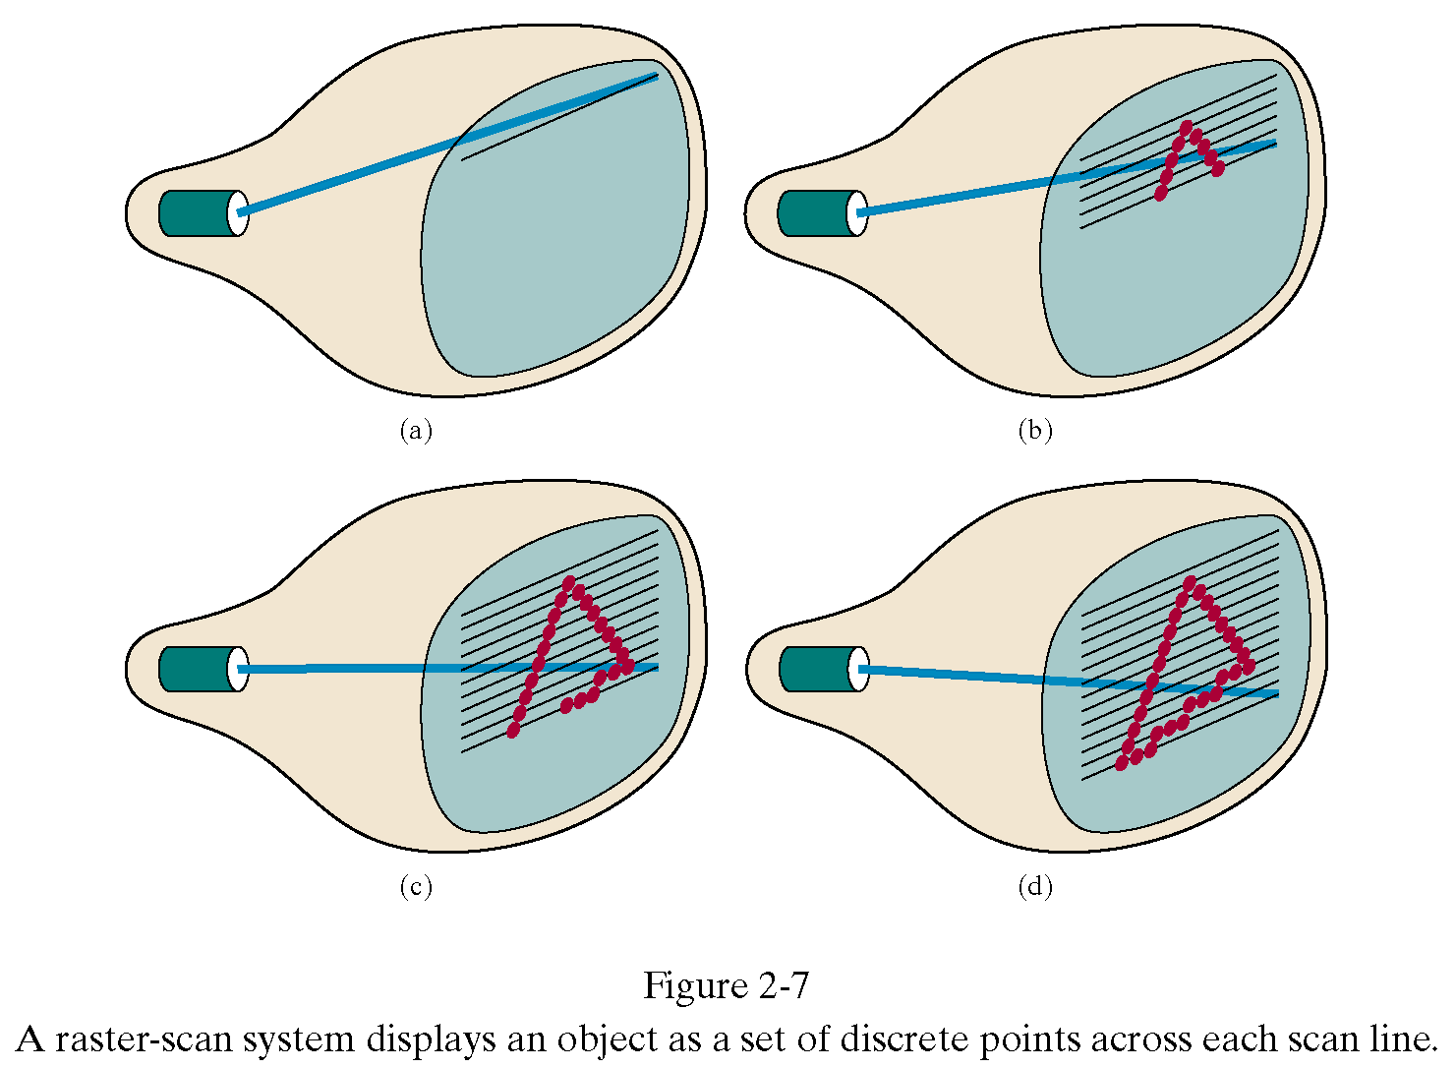
CRT Display Principles
Raster-Scan Displays
Based on TV technology
Electron beam swept across screen one row at a time from top to bottom
Each row is referred to as a scan line

Slide 9

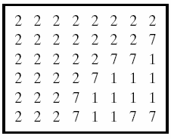
CRT Display Principles
Raster-Scan Displays
Picture elements: screen point referred as “Pixel”
Picture information stored in refresh (frame) buffer
© 2005 Pearson Education

Slide 10
CRT Display Principles
Raster-Scan Displays
Picture information stored in refresh (frame) buffer
The number of bits per pixel in the frame buffer is called depth or bit planes
Buffer with 1 bit per pixel – Bitmap
Buffer with multiple bits per pixel – Pixmap
Interlaced refresh procedure
Beams sweeps across every other scan line

Slide 11
Frame Buffer
A frame buffer is characterized by size, x, y, and pixel depth.
the resolution of a frame buffer is the number of pixels in the display. e.g. 1024x1024 pixels.
Bit Planes or Bit Depth is the number of bits corresponding to each pixel. This determines the color resolution of the buffer.
Bilevel or monochrome displays have 1 bit/pixel
8 bits/pixel -> 256 simultaneous colors
24 bits/pixel -> 16 million simultaneous colors

Slide 12
Specifying Color
direct color :
each pixel directly specifies a color value
e.g., 24bit : 8bits(R) + 8bits(G) + 8 bits(B)
8
8
8
Red
Green
Blue

Slide 13
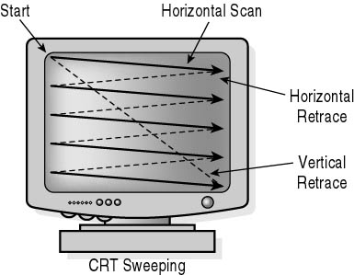
Refresh Rates and Bandwidth
Frames per second (FPS)

Slide 14
Interlaced Scanning
Interlacing of the scan lines in this way allows us to see the entire screen displayed in half the time that it would have taken to sweep across all the lines at once from top to bottom.
To reduce flicker, divide frame into two fields—one consisting of the even scan lines and the other of the odd scan lines.
Even and odd fields are scanned out alternately to produce an interlaced image.

Slide 15
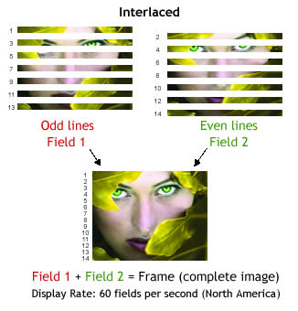

Slide 16
Aspect Ratio
which is now often defined as the number of pixel columns divided by the number of scan lines that can be displayed by the system. (Sometimes this term is used to refer to the number of scan lines divided by the number of pixel columns.)
Aspect ratio can also be described as the number of horizontal points to vertical points (or vice versa) necessary to produce equal-length lines in both directions on the screen.
Frame aspect ratio (FAR) = horizontal/vertical size
TV 4:3
HDTV 16:9

Slide 17
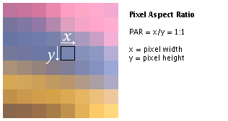
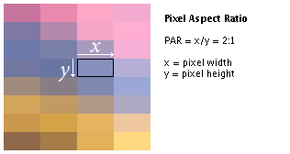

Slide 18
CRT Display Principles
Random-Scan Display Principles
Electron beam directed only to the points of picture to be displayed.
Vector displays, electron beams trace out lines to generate pictures
Picture stores as a set of line-drawing commands
Storage referred as display list, refresh display file, vector file or display program

Slide 19
CRT Display Principles
Sample of Random-Scan displays principles

Slide 20
Thank you

